Slide 1
Data analysis of US Community Health
Xue Xu, 95139
Xiang Liu, 94457

Slide 2
Agenda
Project Overview
Inspirations
Data Pre-processing
Data Analysis
References

Slide 3
Project Overview
Goal: To understand the relation between death rate, cause death diseases, and risk factors of US community from different states. Use the existing data to build model for future analysis
Dataset: chsi_dataset (Community Health Status Indicators (CHSI) to Combat Obesity, Heart Disease and Cancer )
MEASURESOFBIRTHANDDEATH (the Measures of Birth and Death, breast cancer, colon cancer, heart disease, lung cancer, stroke, injury, total number of death, death rate)
- SUMMARYMEASURESOFHEALTH(death rate, unhealthy days, average life expectancy)
VUNERABLEPOPSANDENVHEALTH(environmental and vulnerable factors such as unemployment, work_disable, depression, drug use)
Limitation: Data is limited from 2015-2018

Slide 4
Inspiration
California, Colorado, Illinois, Georgia, Which state has the highest death rate?
Top ten highest death rate counties in these four states
What are the most common disease or vulnerable factor causing the death ?
The relationship between vulnerable factors and death rate(None high school diploma, unemployed, serious work disabled, depression, recent drug use )

Slide 5
Information from the dataset
chose 17 Variables from 4 different files
MEASURESOFBIRTHANDDEATH
Brst_Cancer (breast cancer)
No_HS_Diploma(no high school diploma)
DEMOGRAPHICS
CHSI_County_Name (Name of County)
SUMMARYMEASURESOFHEALTH
VUNERABLEPOPSANDENVHEALTH
Lung_Cancer (lung cancer)
Unemployed(unemployed)
Sev_Work_Disabled(severely work disabled)
Major_Depression(major depression)
Recent_Drug_Use(recent drug users)
CHSI_State_Name (Name of State)
Population_Size (population size)
Population_Size (population size)
MVA (motor vehicle injuries)
Stroke (stroke)
Suicide (suicide)
Injury (unintentional injury)
CHD (coronary heart disease)
Col_Cancer (colon cancer)
Notes:
Breast cancer

Slide 6
Choose 4 states in US
Georgia 159 samples
Colorado 64 samples
California 58 samples
Illinois 102 samples

Slide 7
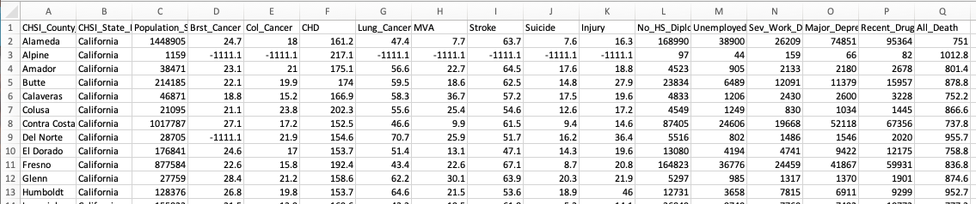
Data Table – Pick Up Columns
Total: 3141 rows x 17 columns

Slide 8
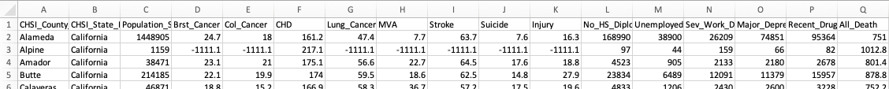
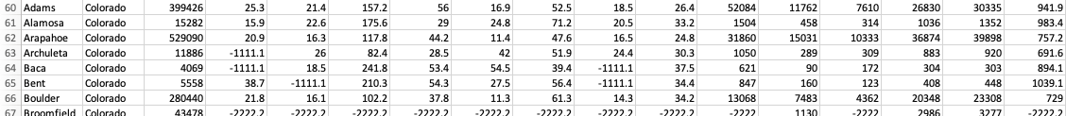
Choose 4 states in US – Cut Rows
+
+
+
383 rows x 17 columns

Slide 9
Data Pre-processing
Validation (Identify missing information, unusual data)
Restructure data

Slide 10
Drop rows for unusual data
300 rows x 17 columns

Slide 11
Exploratory Data Analysis
Boxplot
Barplot
Jointplot
Lineplot

Slide 12
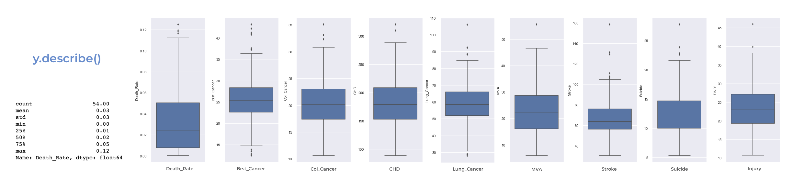
Boxplot
Diseases, suicide, injury of death
Notes:
Summary of dataset

Slide 13
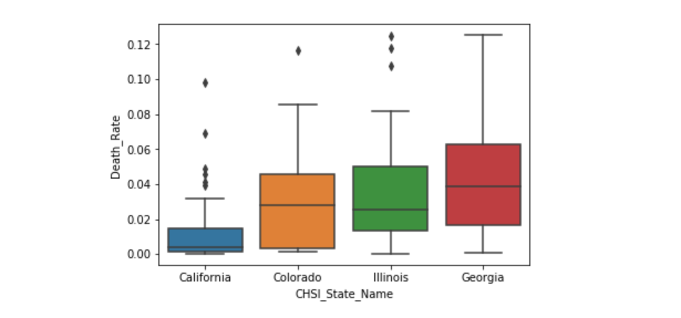
Boxplot
Boxplot for four different States
Georgia has the highest maximum and medium death rate
California has the lowest minimum and medium death rate

Slide 14
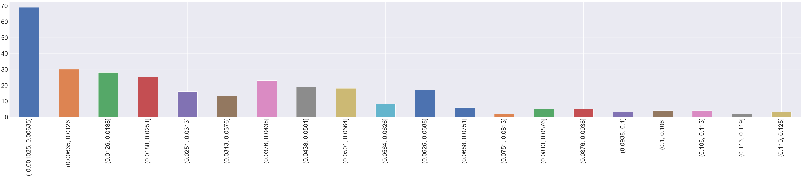
Bar plot
Nearly 70 counties from 300 samples death rate under 0.635%
Notes:
Summary of dataset

Slide 15
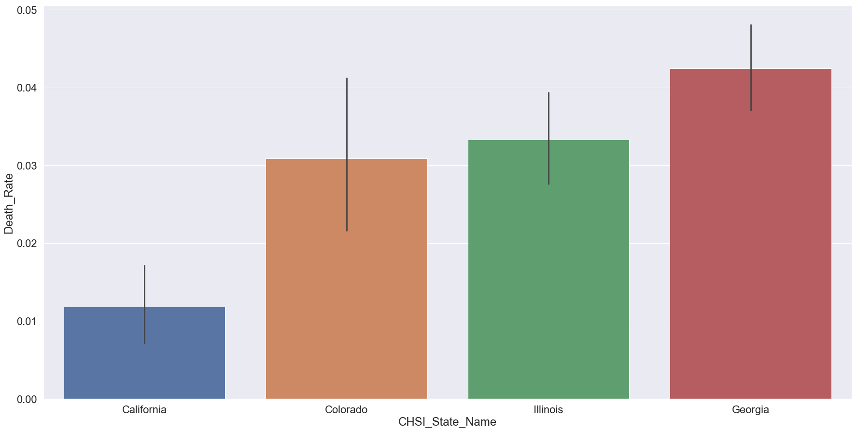
Bar plot
4 different states Death Rate

Slide 16
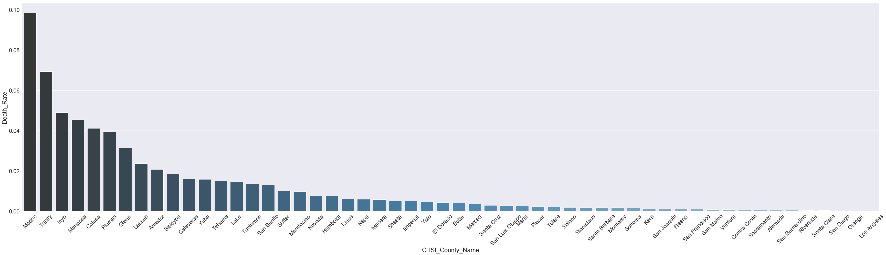
Bar plot
California 54 Counties Death Rate

Slide 17
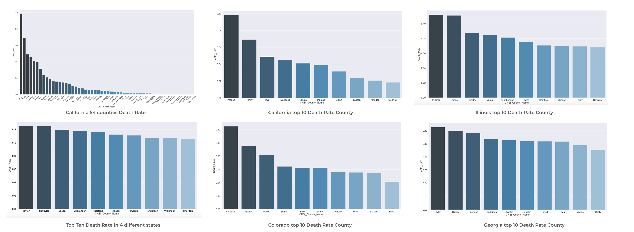
Bar plot

Slide 18
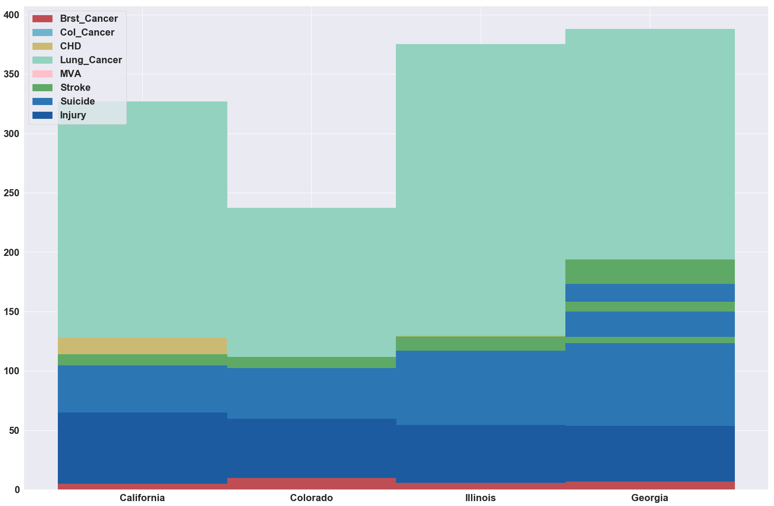
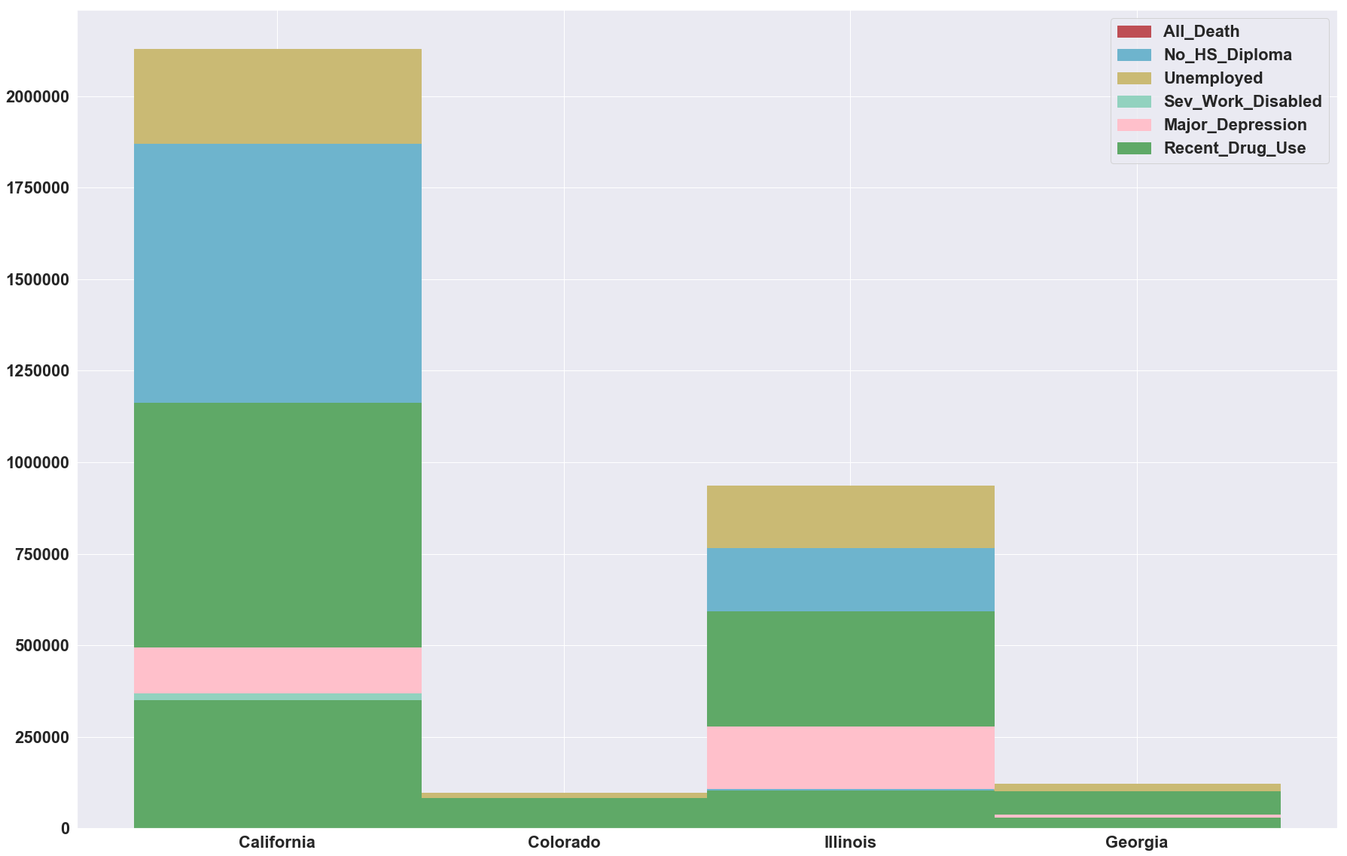
Bar plot
Disease, Suicide, Injury factors
Vulnerable factors

Slide 19
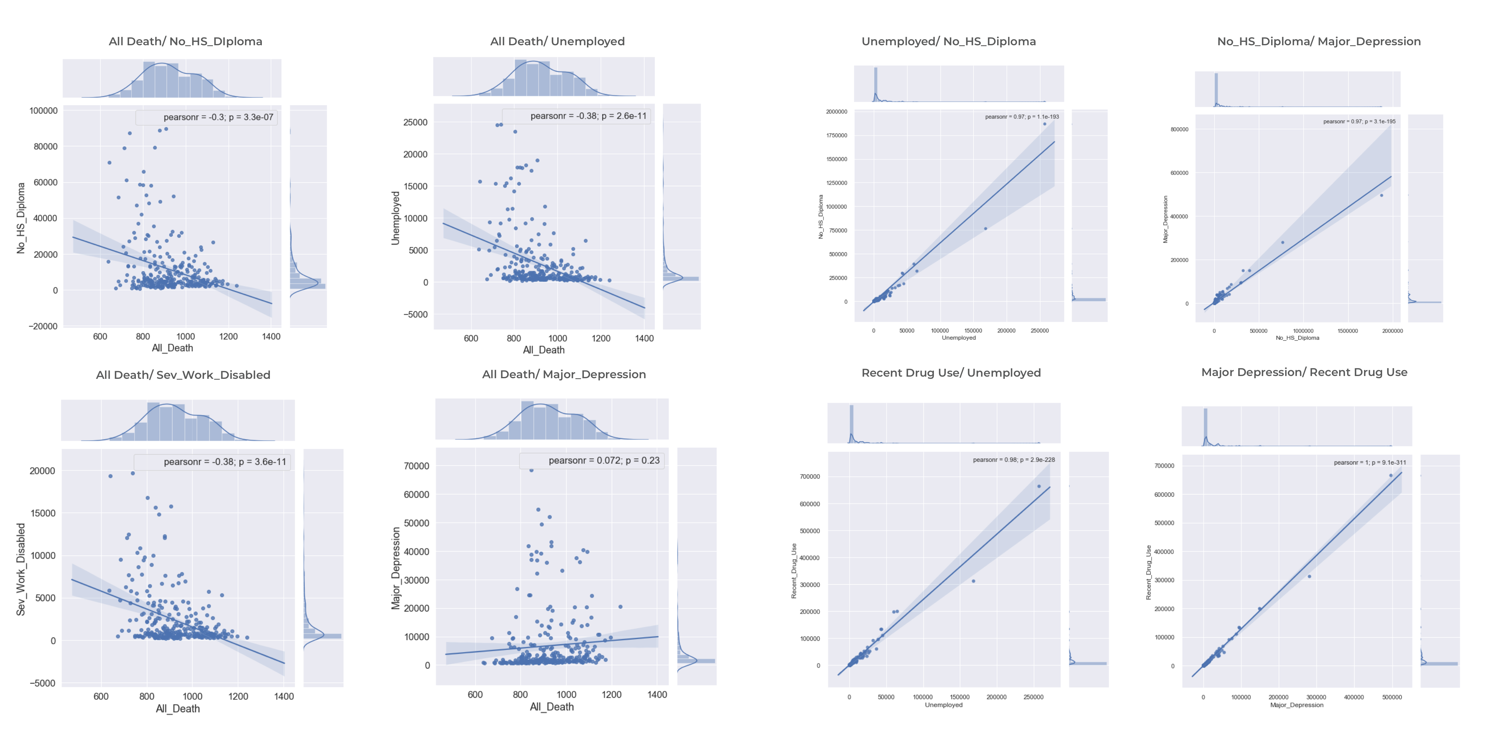
Joint plot
After cleaning up the outliers

Slide 20
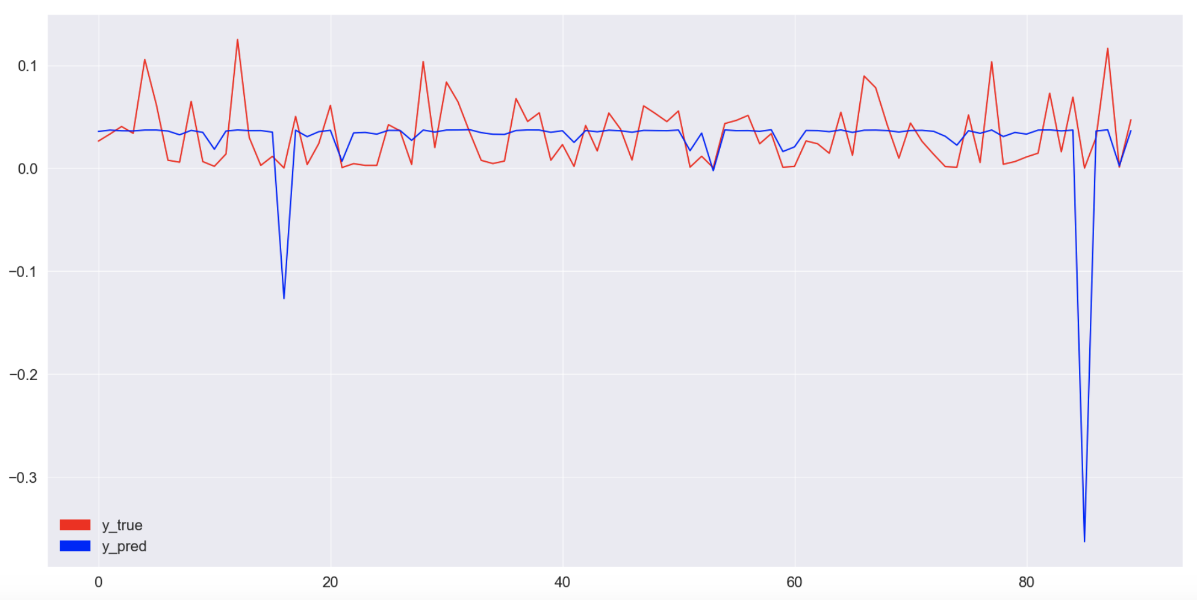
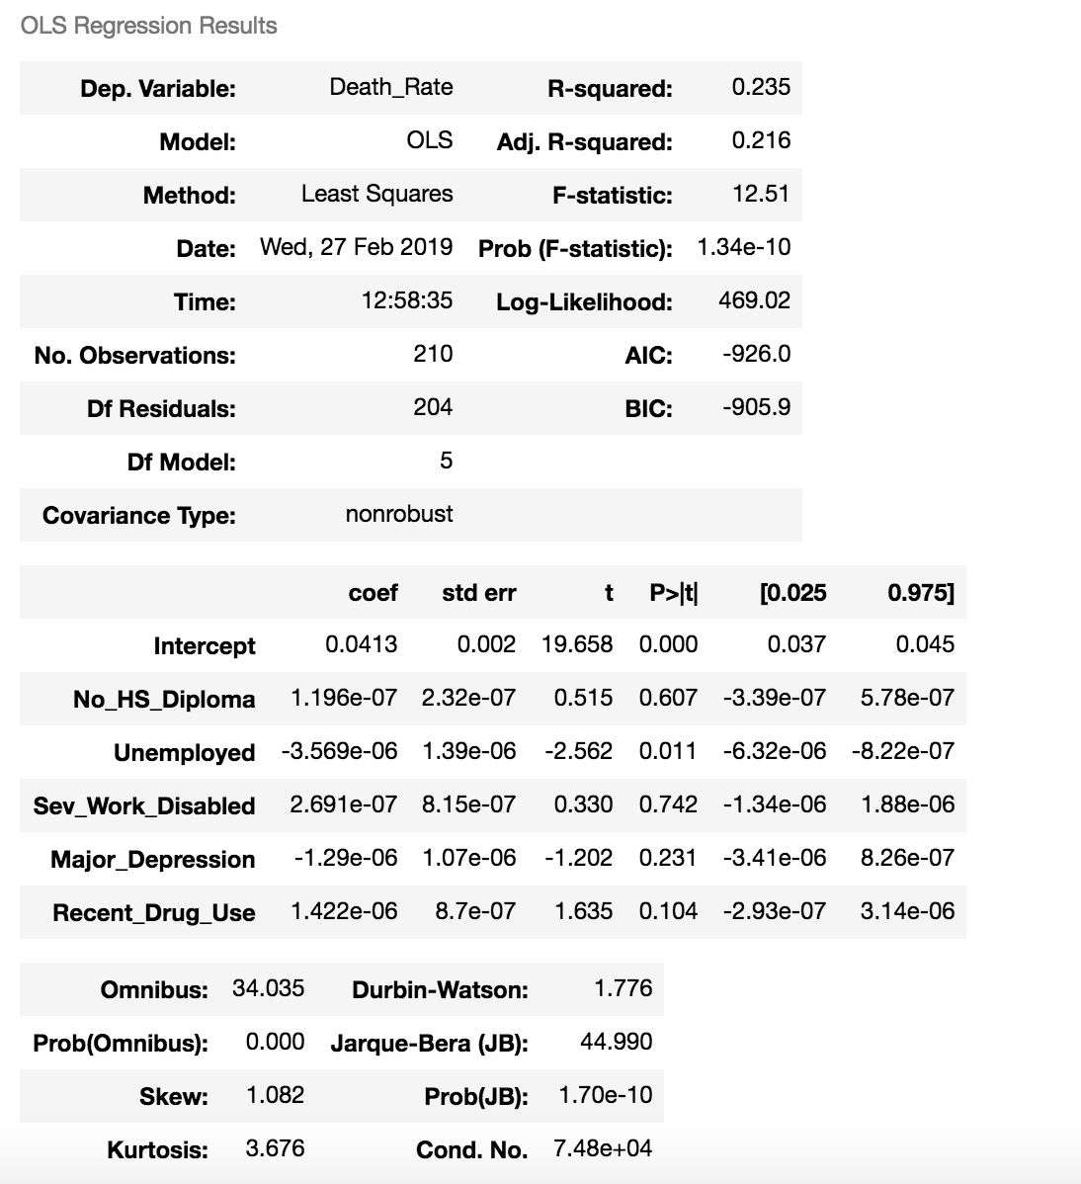
Multiple Linear Regression & Predictor
ols_smf = smf.ols(formula = 'Death_Rate ~ No_HS_Diploma + Unemployed + Sev_Work_Disabled + Major_Depression + Recent_Drug_Use', data = data_train)
Notes:
No ralationship

Slide 21
Summary
Georgia has the highest death rate compared to the other three states
Taylor county has the highest death rate in US
Lung cancer is the most common disease causing death
No High School Diploma, Unemployment, Serious work disabled, Major Depression, Recent Drug Use these vulnerable factors have weak impact on the death rate in these four states

Slide 22
Reference
https://catalog.data.gov/dataset/community-health-status-indicators-chsi-to-combat-obesity-heart-disease-and-cancer
http://www.statsoft.com/textbook/multiple-regression
https://stattrek.com/regression/regression-example.aspx?Tutorial=reg

Slide 23

Thank you for your attention

